Slide 1
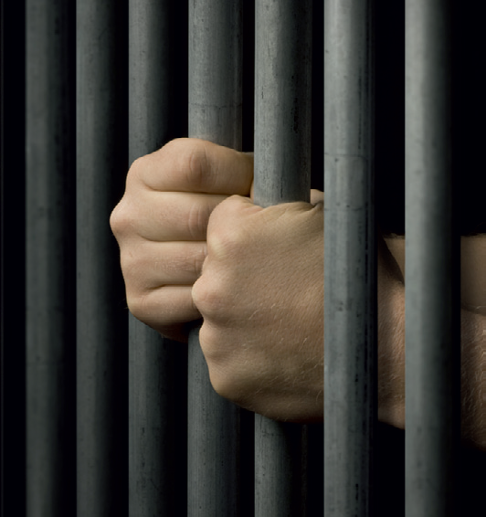
YOUTH CRIME
Year 9 Drama
Lesson 7 – Forum Theatre

Slide 2
Lesson Objectives:
To learn the techniques needed to do forum theatre
To work as a group to decide the desired outcomes for your character
To use forum theatre to achieve a positive outcome for all three characters
Some students will do work in role as their character.
Notes:
This scheme of work consists of a series of six lessons based on the exploration of youth crime. It is hoped that through practical exploration, students will gain a greater understanding of youth crime, the types of crimes that young people commit, and most importantly why. By the end of this scheme students will understand more about the law and young offenders, and the reasons behind young offenders committing crimes. Throughout these lessons students will be developing drama skills such as scriptwriting and forum theatre. The terminology and skills used are in line with the Edexcel GCSE specification.

Slide 3
Lesson Outcomes:
I will stay in role during tasks/activities/performances.
I will confidently perform a character different to myself during tasks/activities/performances.
I will confidently use drama techniques/mediums (forum theatre) during my exploration.
I will use P.E.E.E.E.E. when evaluating my own work and the work of my peers.

Slide 4
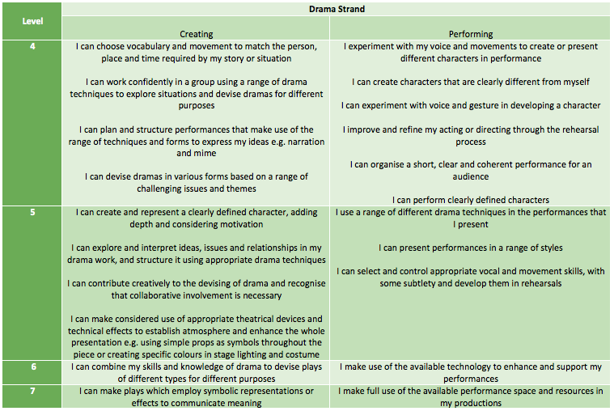
LESSON OUTCOMES

Slide 5
STARTER
3-15 Minutes

Slide 6
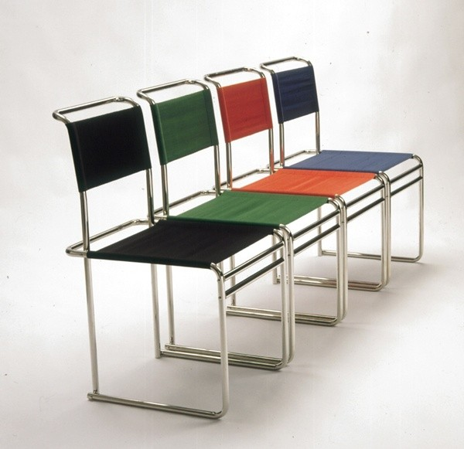
THE SPACE…
Space is set up with four chairs and name placards on each chair.
What do you think is going to happen?
SEMIOTICS
Notes:
Semiotics – reading the signs on the set (study of signs)

Slide 7

WHAT DO WE KNOW OF MARCUS’S STORY?
In your groups you must move around the questions.
Answer and discuss the questions in your groups.

Slide 8
TIMED PAIR SHARE
On the last day he has to have a reformation meeting.
Does anyone know what this means?
A reformation meeting is a meeting that Marcus has with someone from the Crime Prosecution Service and his Youth Worker to decide what he has to do once he leaves. (E.g. Report to Youth Worker once a week; be banned from certain places; observe a restraining order not to go near his victim, etc.) His mum, his guardian, will also be there.

Slide 9
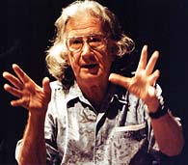
How were they affected?
‘Last lesson you wrote scripts to decide what happened when Marcus and his Dad met. This week we won’t have a script for the reformation meeting, we will explore it through forum theatre.’
Idea of forum theatre:
‘You all work together to decide what the character does. If you want to stop the drama and change what is happening at any point then put your hand up. Those of you that go into role aren’t on your own; you have a whole team behind you!’
Augusto Boal
Notes:
Boal – Invented forum theatre, a practitioner who wanted to use drama to educate and resolve issues, also famous for invisible theatre and Theatre of the Oppressed.

Slide 10
GOOD IMPRO MEANS…
Don’t reject ideas
Suggest improvements for the situation
Conclude with a positive outcome
Work in role
Put hand up to indicate stopping the drama.
Why do you think these rules are important?

Slide 11
WARM UP
15-25 Minutes

Slide 12
PLANNING
In your groups you must assign the following parts:
Marcus
Youth Worker
Crime Prosecution Worker
Mum.
The fact cards will help you improvise your part of the drama.
You must discuss the questions posed to you in the resource, focusing on the last question:
What do you want to achieve from the reformation meeting?
Notes:
Split the class into four groups for their preparation of the forum theatre. It is useful to consider abilities when deciding these groups. Forum theatre is a difficult task and if possible, it would be beneficial to have a gifted or talented student in each group.

Slide 13
Possible Outcomes
Marcus: Wants to get his head
down and forget about it, he
just doesn’t want to go back to
the YOI.
CPW: Wants Marcus to attend
behaviour classes at the
YOI each week and have a
restraining order put on him so
he can’t see his dad.
Youth Worker: Wants Marcus
to report to him every week to
make sure he is staying on the
right tracks and really wants
Marcus to have a good life.
Mum: Wants Marcus to make
amends with his dad; she
doesn’t necessarily want them
to be friends, but she thinks it’ll
help Marcus to move on.
Notes:
Teacher to circulate among groups and help them decide their character’s motivation and desired outcomes for the reformation meeting.

Slide 14
WHOLE CLASS WORK
25 - 50 Minutes

Slide 15
WHOLE CLASS…
One student from each group should now come and take the place of their character on the chair.
Other people will get a chance to go into role; they will swap during the forum theatre.
Think about the outcome that your character wants.
Students can put their hands up to stop the performance, groups can discuss what their next move will be and confer, etc.
Teacher facilitates the performance, ensuring that the students stick to the forum theatre rules that are displayed.
Notes:
Re-focus. Stop the performance after about 5 minutes (or when appropriate) to remind students of what their characters need to be achieving. Allow students to go back into their groups and discuss what they want to happen next. What compromises are you willing to make? Reiterate that they will have a whole team to support them so they are not alone while in role. Students in role may feel more comfortable if the chairs are in a circle with their groups sitting behind them, instead of sitting in front of the class in a performance space. Stop the performance as often as is needed and allow students to swap who is in role and confer until a compromise is reached that all characters are happy with. If students are finding it difficult to come to a conclusion, you may need to prompt groups as to what their compromise could be.

Slide 16
PLENARY
50 -60 Minutes

Slide 17
TIMED PAIR SHARE
What do you think of forum theatre?
What skills do you need to use in order to be good at improvising?
In what situations do you think forum theatre would be useful?
Notes:
Class discussion: Open the following questions up to the class. Allow them time to Think/ Pair/Share before directly questioning for answers.

Slide 18
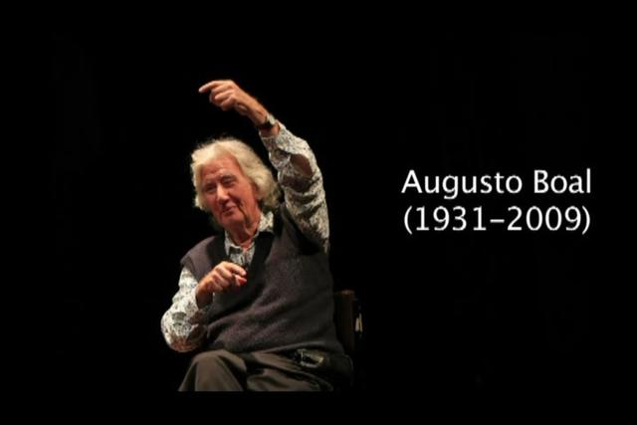
AUGUSTO BOAL
Augusto Boal used forum theatre to solve working class problems in Brazil.
Huge groups would gather and create big forum theatre performances to help solve political problems!

Slide 19
HOW DID YOU DO TODAY?

Slide 20
LESSON OUTCOMES ADD LEVELS and DIFFERENTIATION
I will stay in role during tasks/activities/performances.
I will perform a character different to myself during tasks/activities/performances.
I will confidently use drama techniques (thought tracking/still image) during my exploration.
I will use P.E.E.E.E.E. when evaluating my own work and the work of my peers.

